Slide 1
Robot Tutorial
Henrik Christensen, Charvi Shukla, Shiladitya Biswas
Credit to Chenghao Li, Henry Zhang, David Paz for Initial version

Slide 2
Overview
System Overview
UART connection and WiFi connection
ROS2 packages
Control for the robot
Camera Driver
Apriltag Detection

Slide 3
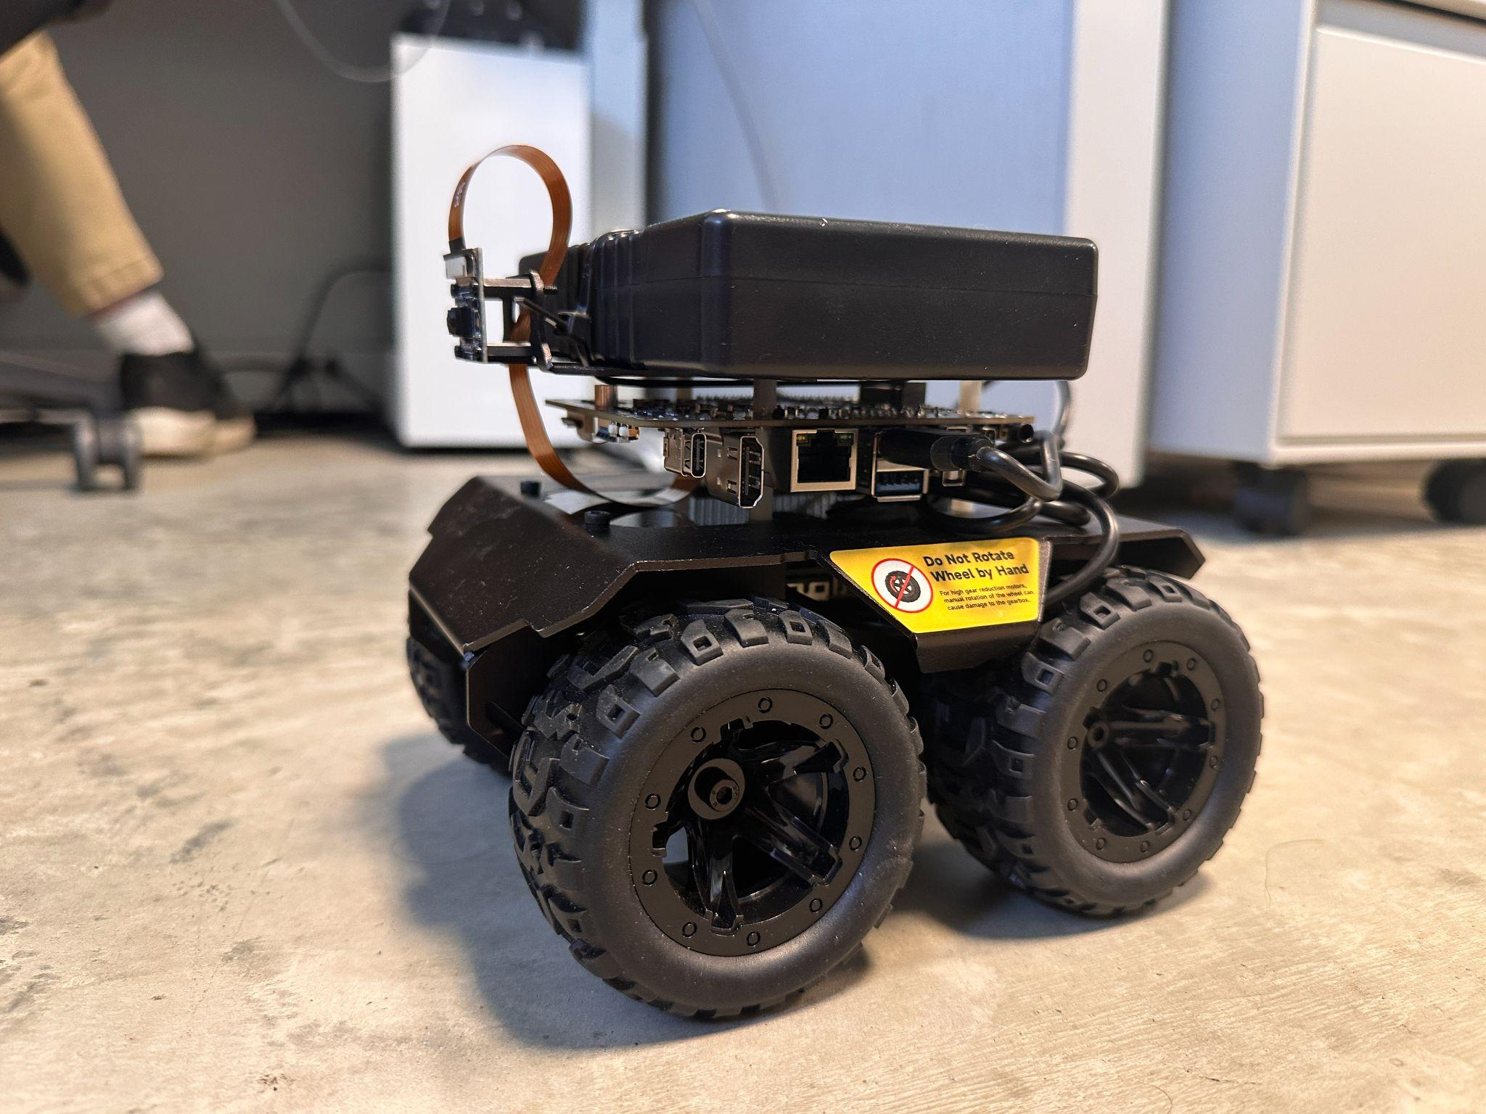
Waverover System Overview
Robot body: Waverover
  4 Wheels Differential Drive
  Battery
  Raspberry Pi Camera
  IMU
Robot Head: Qualcomm Rubik Pi
  Kryo™ 670 8 cores CPU
  RAM 8 GB LPDDR4x
  12 TOPS On-device AI capability
Robot Brain: Software
  System: Ubuntu 24.04
  ROS2 Jazzy
  Custom ROS2 Packages: robot_vision_camera, robot_contrl, apriltag_ros

Slide 4
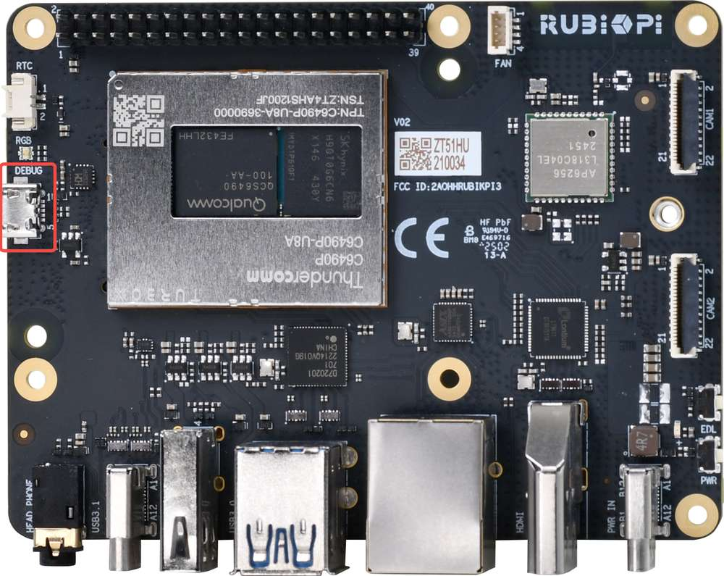
Setup Debug UART (link)
Connect Rubik Pi through micro-usb cable.
  Install screen/minicom for ubuntu and MacOS Or PuTTY for Windows
$ sudo apt update
$ sudo apt install screen
$ ls /dev/ttyACM*
$ sudo screen /dev/ttyACM* 115200 or sudo minicom -D /dev/ttyACM* -b 115200
  Account: ubuntu
  Password: rubikpi123
  passwd

Slide 5
WiFi connection
Set-up WiFi connection through terminal (link)
  nmcli
$ nmcli dev wifi connect <WiFi-SSID> password <WiFi-password>
  nmtui
$ sudo nmtui
Access over SSH (link)
$ ssh <user name>@ip-address
$ ssh ubuntu@192.168.90.181

Slide 6
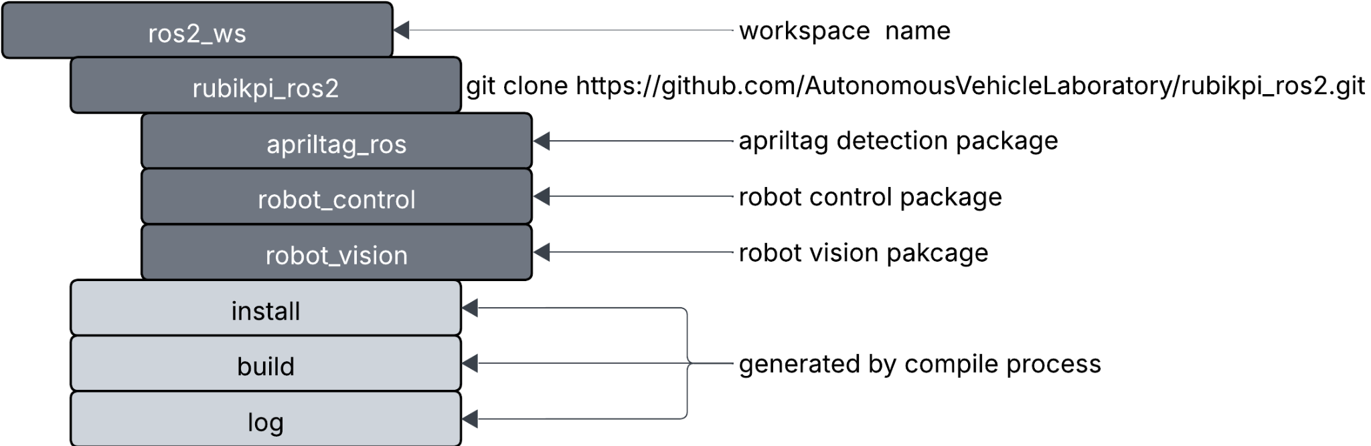
Custom ROS2 Packages

Slide 7
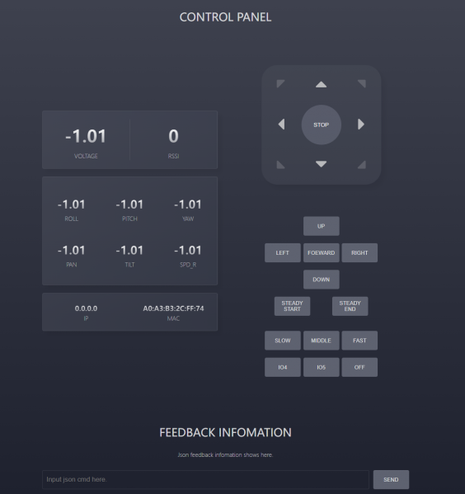
Robot Control of Waverover (link)
Connect to the robot's WiFi network
  ssid: UGV
  password: 12345678
Access the web-based user interface
  open the Google Chrome browser and type "192.168.4.1" in the address bar
Control robot using JSON
  {"T":1,"L":0.5,"R":0.5}
  L is the speed of the left wheel, R is the speed of the right wheel, and the speed range is -0.5 ~ +0.5, positive value forward, negative value backward.
  {"T":126}
  get IMU data, including heading angle, geomagnetic field, acceleration, attitudes, temperature, etc.
  {"T":3,"lineNum":0,"Text":"putYourTextHere"}
  OLED screen display content settings.
  lineNum parameter for the line settings, can be: 0, 1, 2, 3, a total of 4 lines of content can be displayed.

Slide 8
Robot Control of Waverover (ROS2)
Motor control in ros2 using serial port /dev/ttyUSB0 (link)
Add ROS2 Jazzy to your path
$ source /opt/ros/jazzy/setup.bash
Build ROS2 packages
$ cd /path/to/ros2_ws/
$ colcon build
$ colcon build –packages-select package_name
$ colcon build –symlink-install
Add workspace to your path
$ source /path/to/ros2_ws/install/setup.bash

Slide 9
Robot Control of Waverover (ROS2)
Check ROS2 Domain ID:
$ echo $ROS_DOMAIN_ID
Run nodes (link)
$ ros2 run robot_control motor_control #waverover motors node
$ ros2 run robot_control keyboard_control #keyboard control node
Or (link)
$ ros2 launch robot_control robot_teleop_launch.py #keyboard control launch file
$ ros2 topic pub --once /motor_commands std_msgs/msg/Float32MultiArray "data: [0.2, 0.2]"

Slide 10
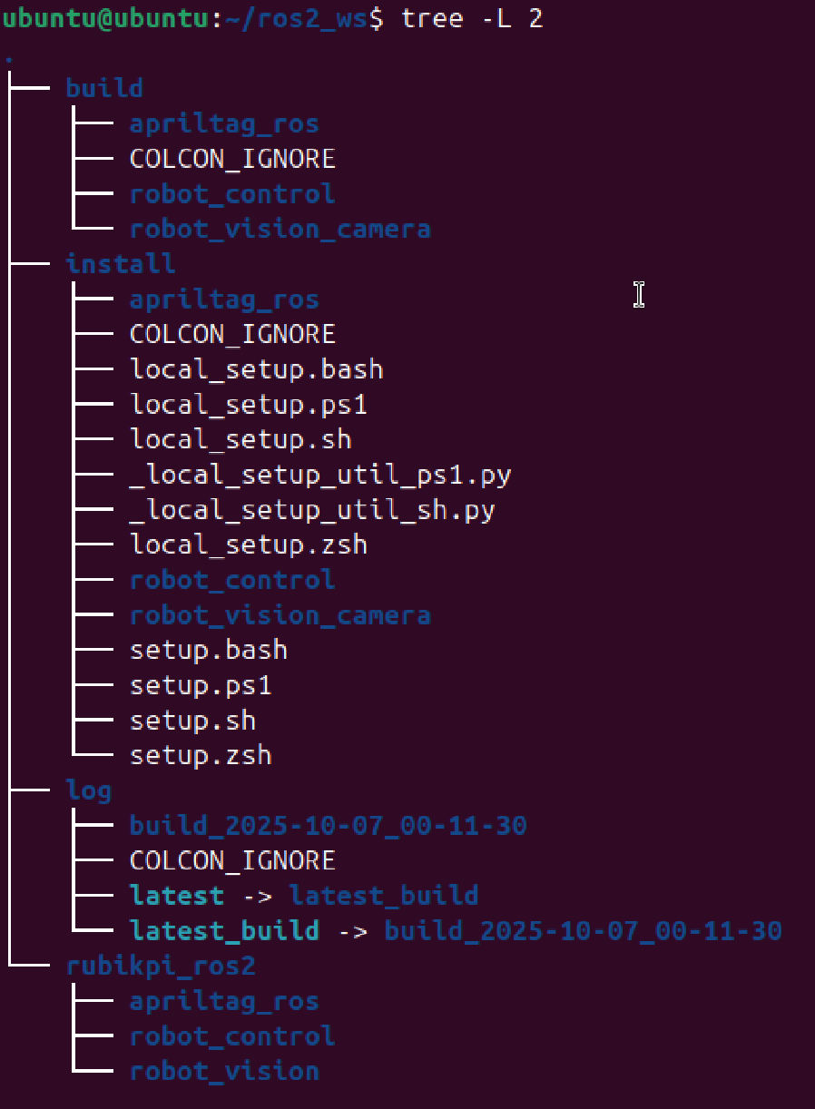
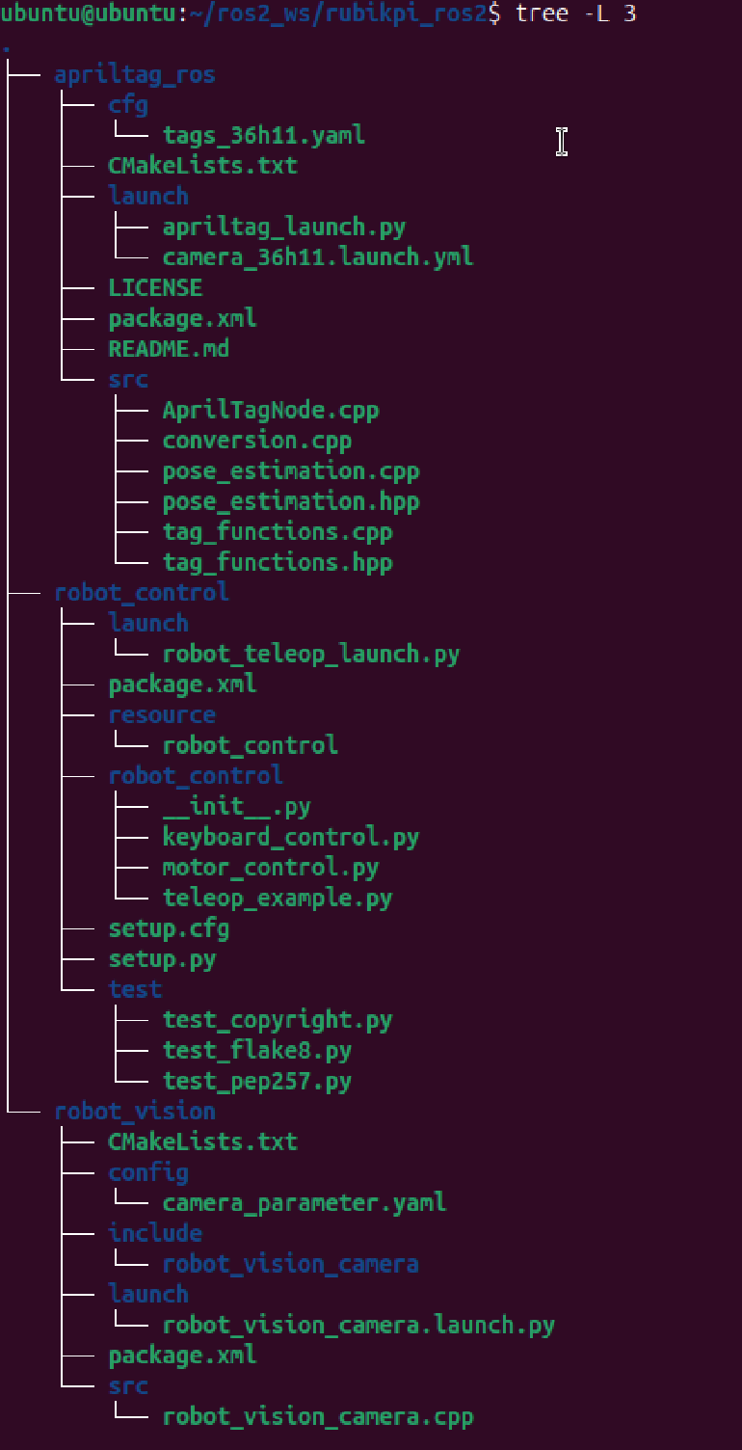
Organization of
your workspace
tree -L 2

Slide 11
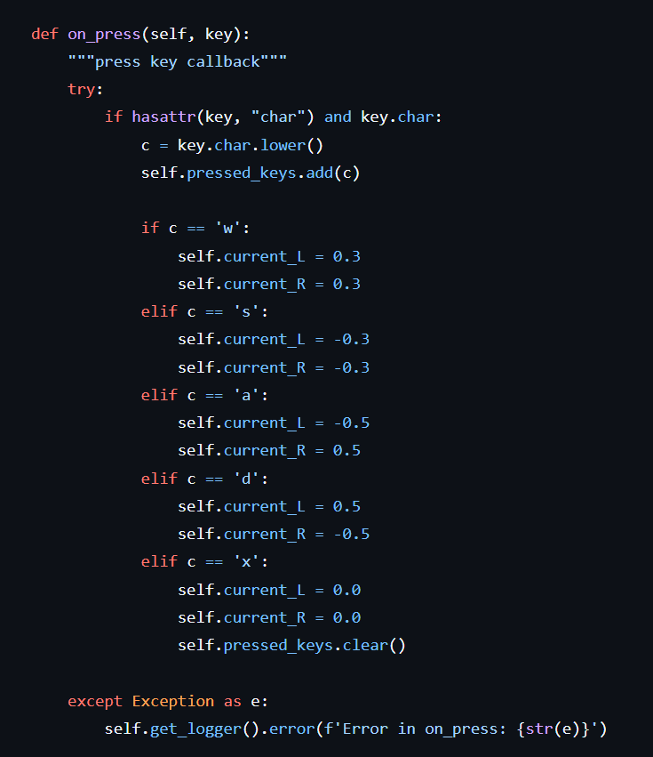
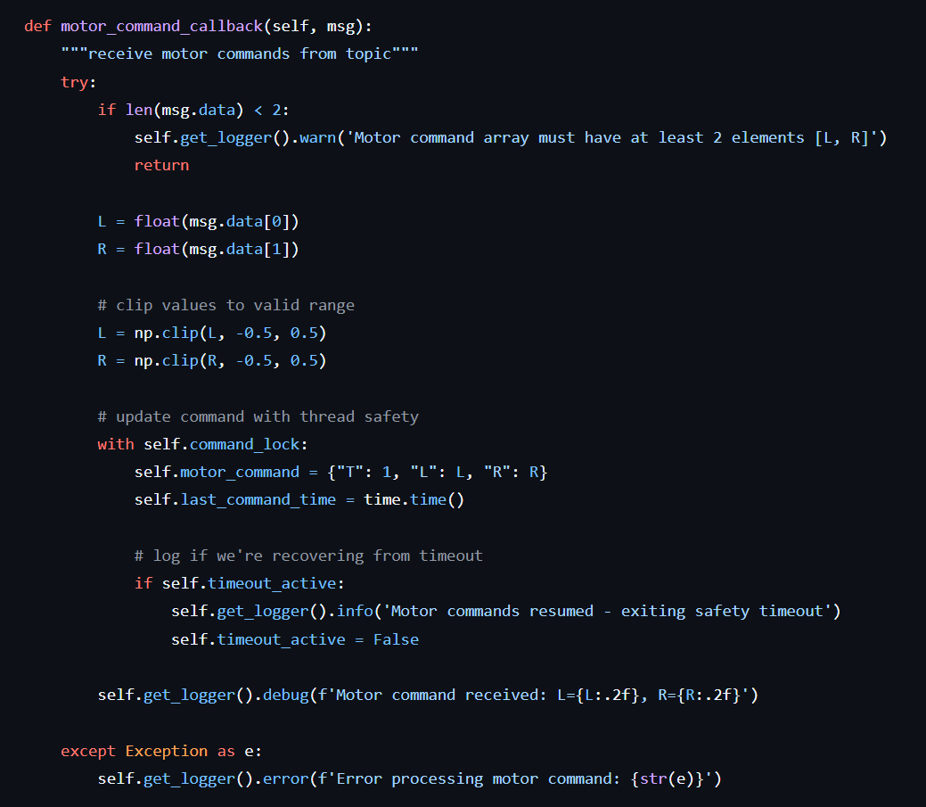
Robot Control of Waverover (ROS2)
keyboard_control.py
motor_control.py

Slide 12
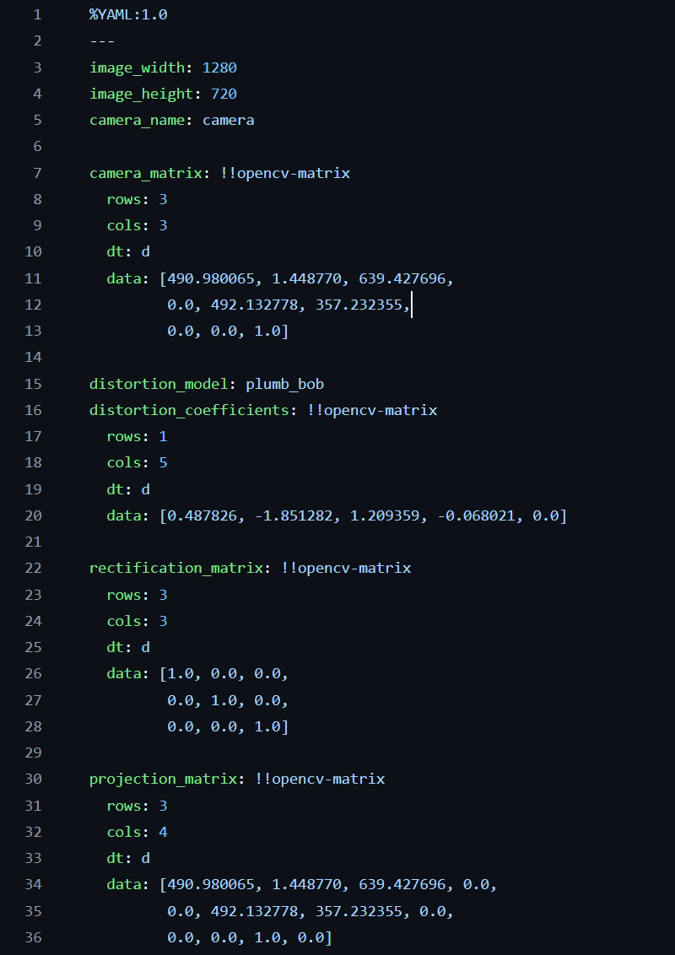
Launch Camera
Run camera driver nodes (link)
$ ros2 run robot_vision_camera robot_vision_camera #Camera Driver
Or (link)
$ ros2 launch robot_vision_camera robot_vision_camera.launch.py #This included camera driver and foxglove bridge
Camera Parameter

Slide 13
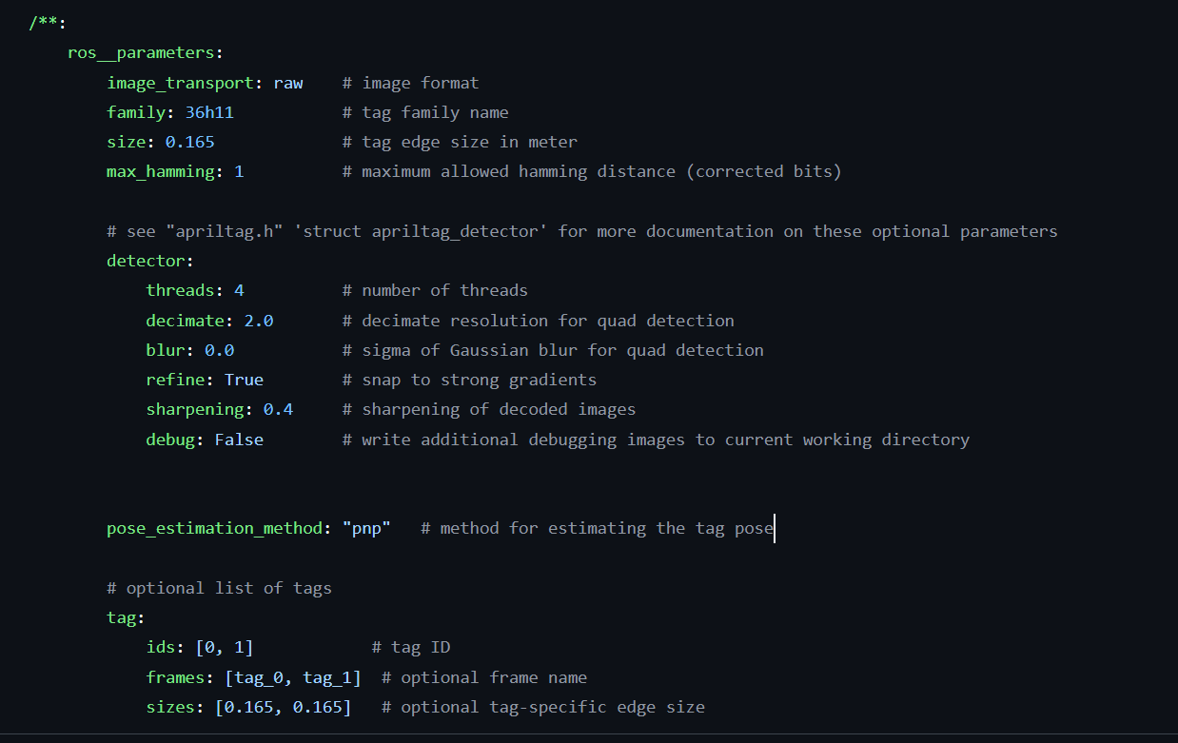
AprilTag Detection
Run Apriltag detection node
$ ros2 run apriltag_ros apriltag_node --ros-args \
-r image_rect:=/camera/image_raw \
-r camera_info:=/camera/camera_info \
--params-file
Or (link):
$ ros2 launch apriltag_ros apriltag_launch.py

Slide 14

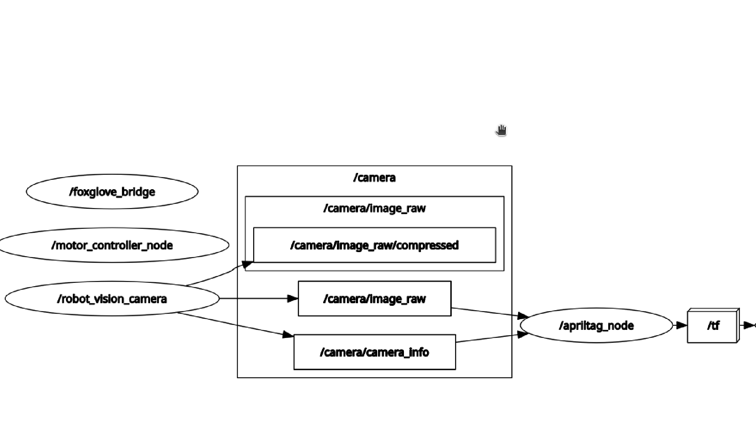
AprilTag Detection

Slide 15
Reference
Waverover robot: link
Rubik Pi 3: link
ROS2 Jazzy: link
Rubik Pi 3 AP Mode: link
Questions?
Notes:
Add link

